Slide 1


Polar Coronal Hole Variations Over Solar Cycle 23
Nishu Karna
Mentor: Dr. William Dean Pesnell
Code: 671
SESI Program-2010
Goddard Space Flight Center
Date: August 4, 2010

Slide 2
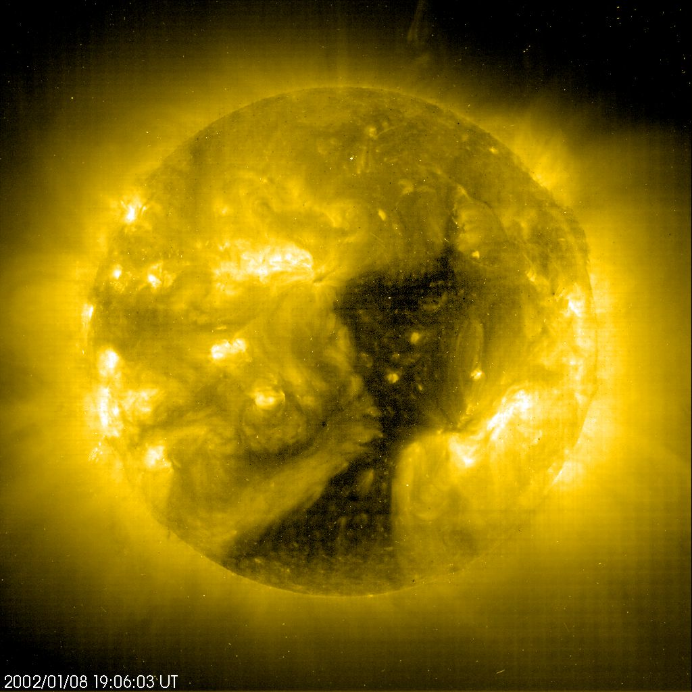
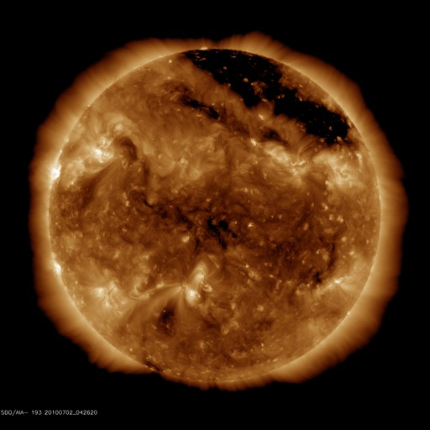
Coronal Hole :-
Large dark regions in the Sun’s corona that are cooler and have lower density plasma than average.
First observed in X-ray in 1974.
Well seen via UV and X-ray telescopes flown above the Earth's atmosphere.
Open magnetic field lines.
Source of high speed solar wind.
May predict the magnitude of upcoming solar maximum.
Polar coverage during low solar activity - Polar Coronal Hole

Slide 3
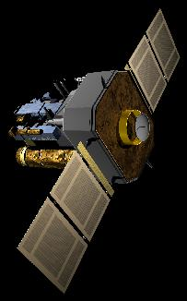
Solar and Heliospheric Observation (SOHO)
International collaboration between ESA and NASA
Launched in December 2, 1995 by Atlas Centaur Rocket
Orbits around the Sun-Earth First Lagrangian Point (L1)
Twelve instruments on board
Used Extreme UV Imaging Telescope (EIT)

Slide 4
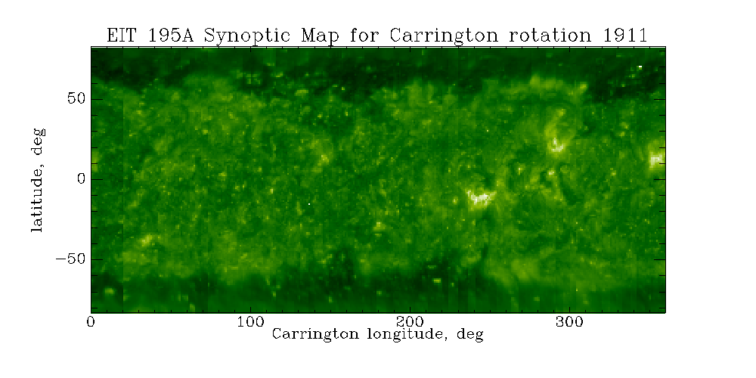
My Work
Used Elena Benevolenskaya’s online SOHO/EIT synoptic map archive.

Slide 5
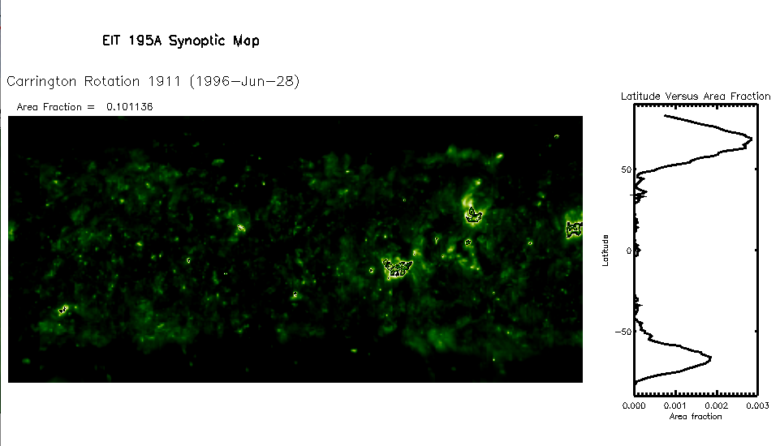
My Work
Find area of Polar Coronal holes from Carrington Rotation (CR) 1911 to CR 2055 (June 28, 1996 to March 31, 2007).

Slide 6
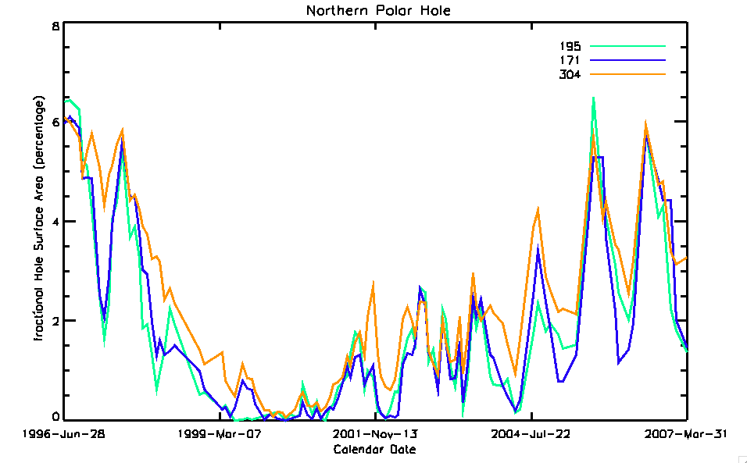
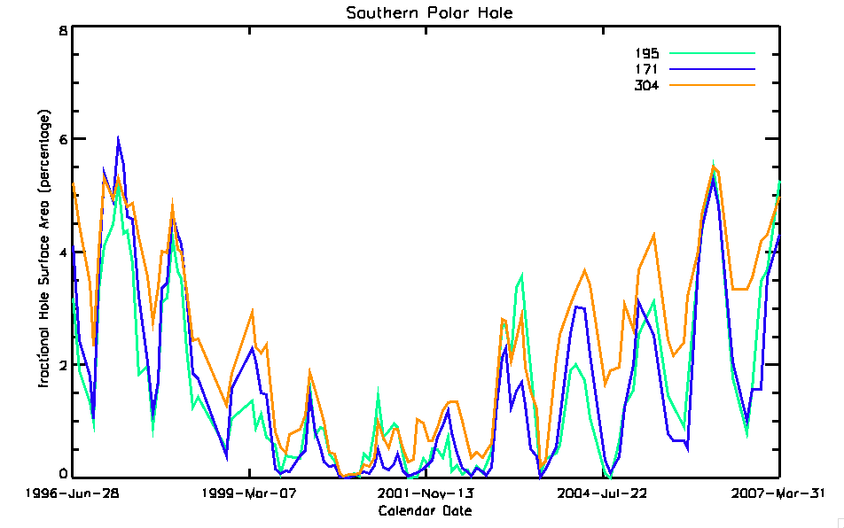
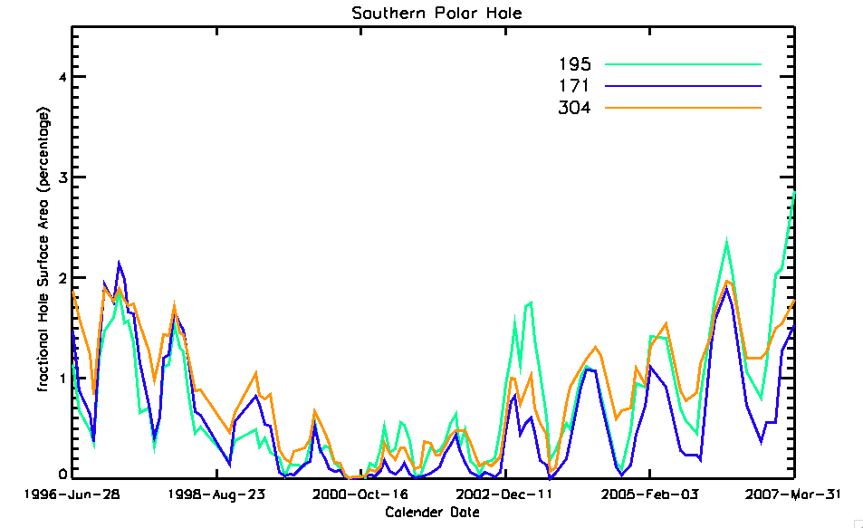
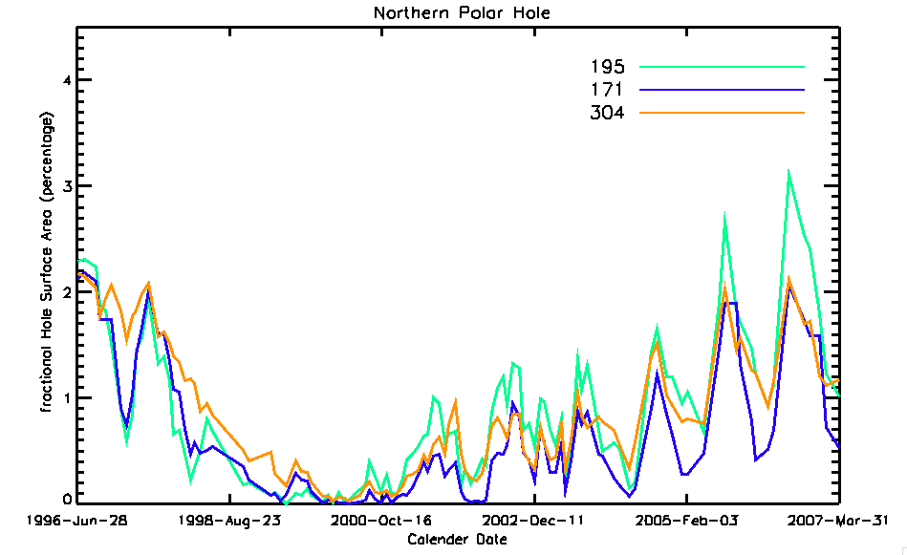
(a)
(b)
(a) Northern polar coronal hole area and (b) Southern polar coronal hole area with respect to Calendar date from June,28 1996 to March 31, 2007 (CR 1911-CR 2055) for the 195 Å,171 Å and 304 Å wavelengths.
(a)
(b)

Slide 7
Solar B Angle:
The latitude position of the center of the solar disk which varies according to change in the tilt of the solar axis relative to the Earth.
Earth’s orbit
Line of Equinoxes
Sun’s Axis

Slide 8
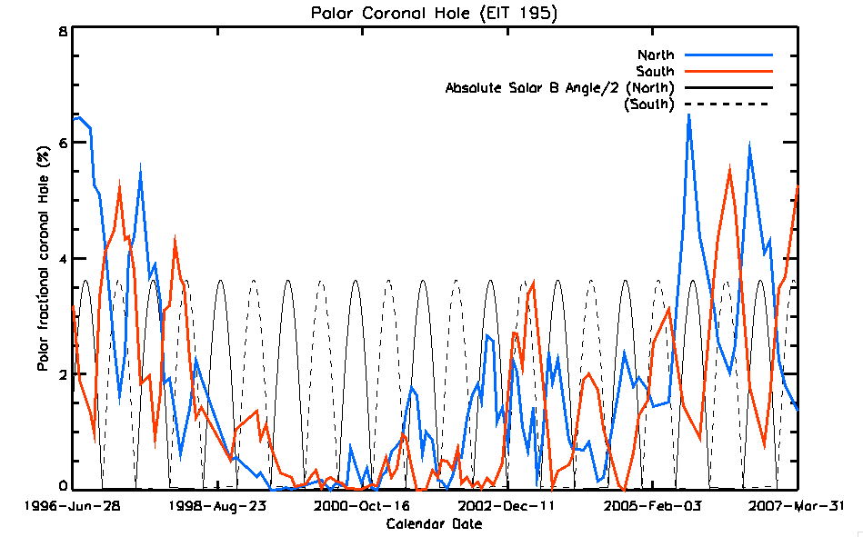
Variation of the polar coronal hole (Northern, red solid line; Southern, blue solid line) in the 195 Å wavelength.

Slide 9
Result:
The estimated fractional areas for the Northern hole the area was 5.0% in 1996 and 4.5% in 2007.
For the Southern hole was 4.5% in 1996 and 4.0% in 2007.
Drawback:
The latitude only ranges between ±83°.
Missing latitude contributes ~0.75% of the Sun's area at each pole.
Distorted image when a 3D sphere is projected into 2D image.

Slide 10
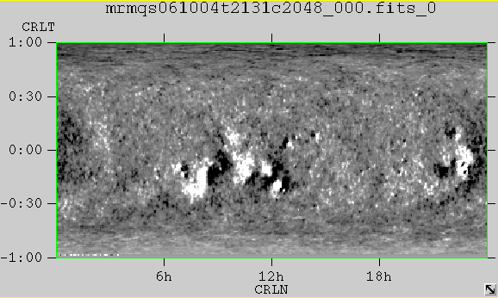
Future Work:
Work with Magnetograms to better determine coronal hole area.

Slide 11


